Slide 1
AWS Lambda
A Small Research
Anjali Tandel
Lily Yun Li

Slide 2
Introduction
AWS Lambda is serverless computing platform provided by Amazon as a part of Amazon Web Services.
It is a computing service that runs the code in response to events and automatically manages the resources that are required by the code.

Slide 3
What is AWS Lambda
AWS lambda is one of the services that falls under the 'compute' domain of service that AWS provides.
Compute => Aamazon EC2, Amazon EBS, Amazon Elastic Load Balancing, AWS Lambda,etc
AWS Lambda can run our code in response to the events of other services.
It can run code of any type of Application.
Only thing lambda needs is our code should be written in the languages that are supported by AWS Lambda. It Supports node JS, Java, C#, go and python.

Slide 4
Features of AWS Lambda
Serverless Platform: We don't have to worry about Server Management, just write the code and upload it to lambda.
Scaling : It scales our application based on the size of workload.
Billing : Billing on Lambda meter on the seconds. We only have to pay the amount of time our code is running.

Slide 5



Where AWS Lambda is used?
There are huge number of ways that AWS Lambda is used by businesses. Some examples are described as following.
AWS Lambda is used to process images when it is uploaded in S3 bucket.
IMAGES
S3 Bucket
AWS Lambda is Triggered
The Images are processed and converted into thumbnails based on the device .

Slide 6



AWS Lambda is used to analyze social media data.
Trending Hashtags
Social Data is added into Amazon Kineses
AWS Lambda is Triggered
The Data is stored into Database which can be used by business users.

Slide 7




Some of the Companies that use AWS Lambda are,

Slide 8



How AWS Lambda works?
Multiple Requests
AWS Lambda
Multiple Requests
Clients
#Container4
#Container1
Clients can be anyone who is sending request to the AWS lambda. For eg. An application or other amazon services .
#Container2
#Container3
Only pay for processing time

Slide 9
How AWS Lambda works?
Client send the request to AWS lambda. Client can be an application or the other amazon service which send the request AWS Lambda.
These requests are given to a container to handle. A container contains the code the user has provided to satisfy the query.
Container image is a lightweight standalone executable package of a piece of software that includes the code,runtime,system tools,system libraries and any other settings needed.
With an increasing number of requests , increasing number of containers are created. when requests reduces ,the number of cotainers also reduces which helps in saving cost.
You are only charged for the amount of time that a function is running inside these containers

Slide 10
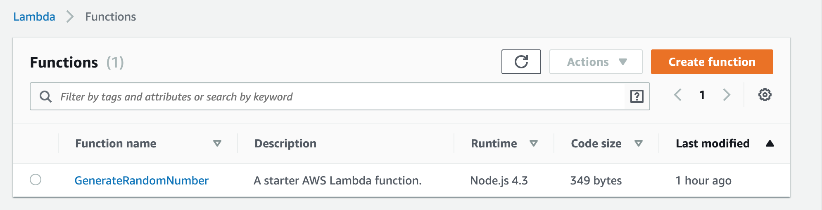
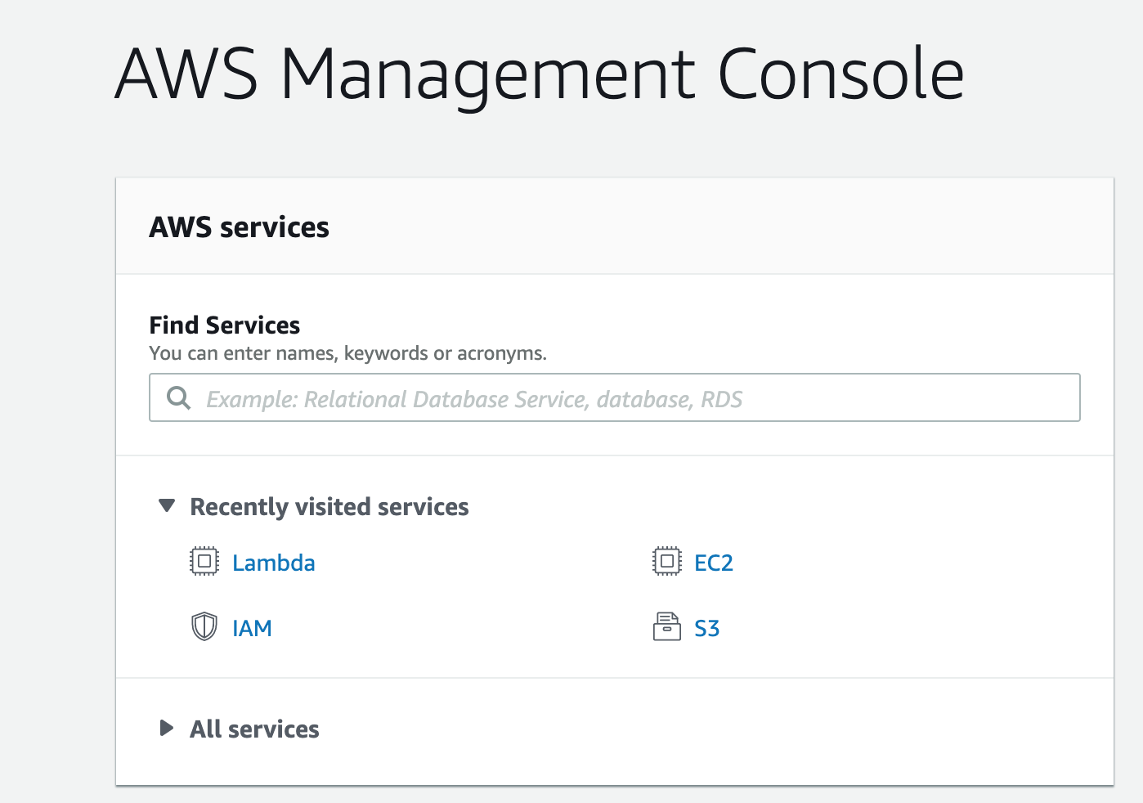
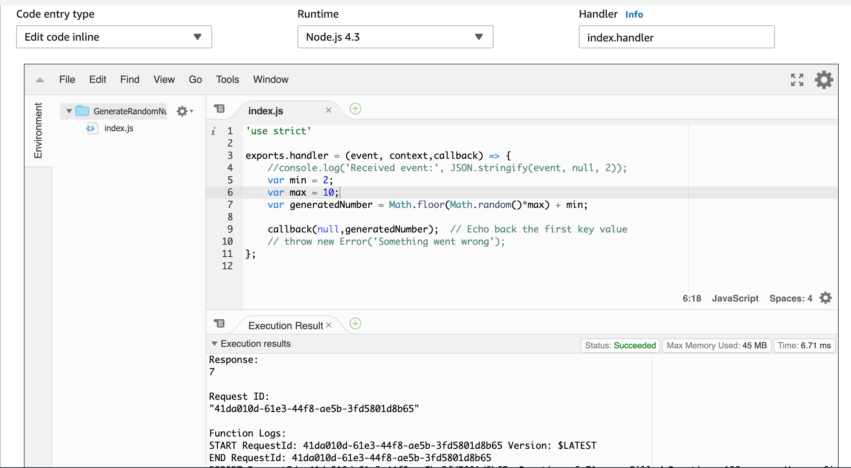
Getting Started
https://docs.aws.amazon.com/toolkit-for-eclipse/v1/user-guide/lambda-tutorial.html
https://docs.aws.amazon.com/lambda/latest/dg/getting-started-create-function.html
https://aws.amazon.com/getting-started/tutorials/run-serverless-code/

Slide 11
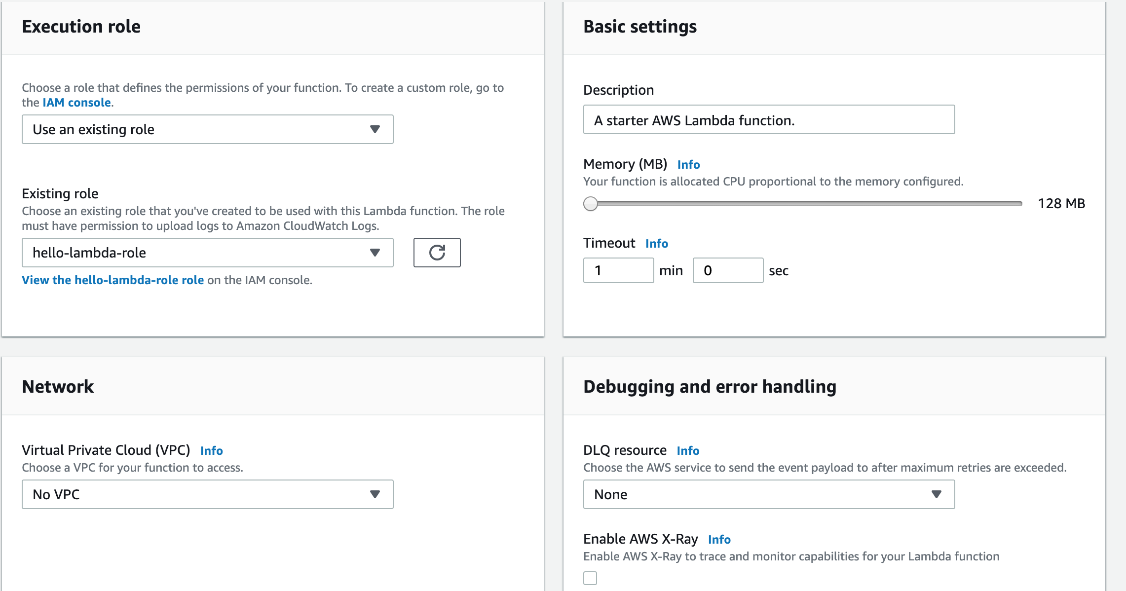
Getting Started

Slide 12
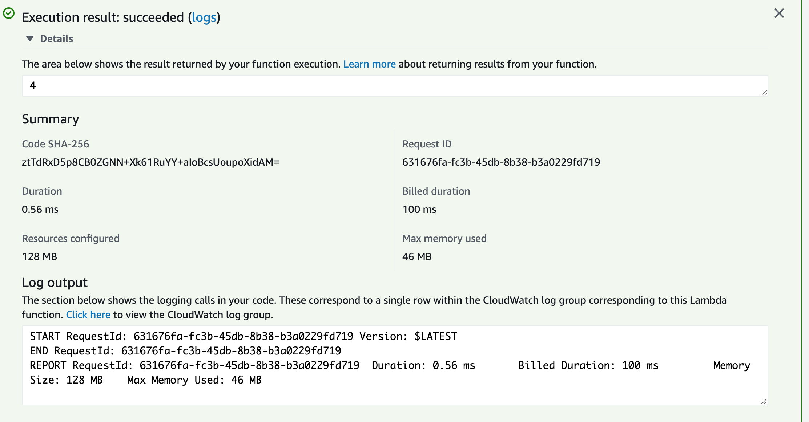
Getting Started

